Slide 1
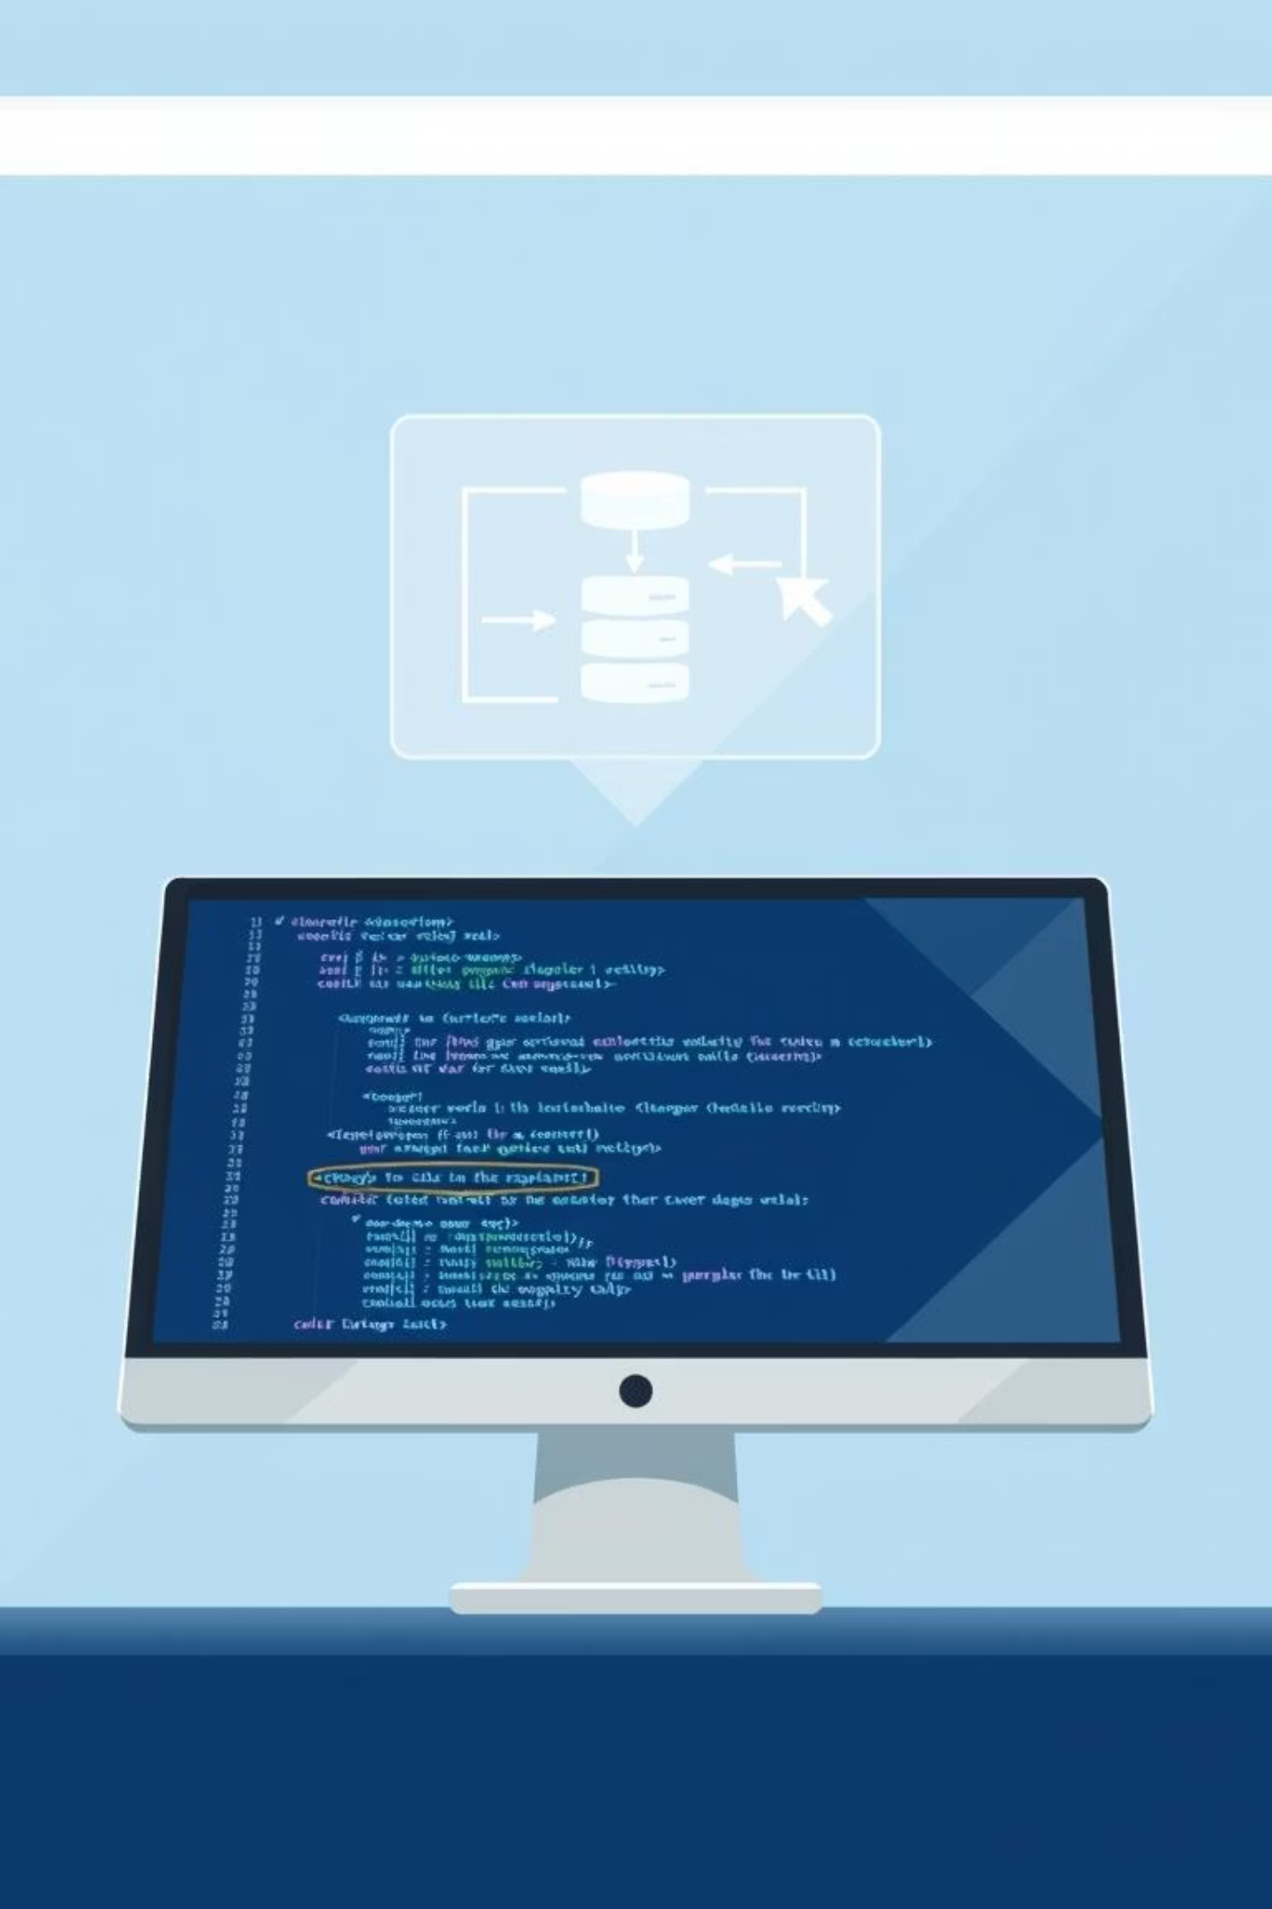
PHP Programming: Database Migrations Without Frameworks
Explore efficient strategies for managing database schema changes in PHP projects, focusing on both manual methods and powerful, framework-agnostic tools.

Slide 2

What Are Migrations and Why Are They Essential?
Structured Database Evolution
Team Synchronisation
Backend Development Importance
Migrations provide a systematic way to manage and track changes to your database schema, including creating, altering, and dropping tables, columns, and indexes.
They enable development teams to keep their database structures in sync, much like version control for your codebase, ensuring everyone works with the same schema.
Crucial for backend stability and scalability, migrations simplify project maintenance, facilitate feature development, and ensure data integrity across environments.

Slide 3
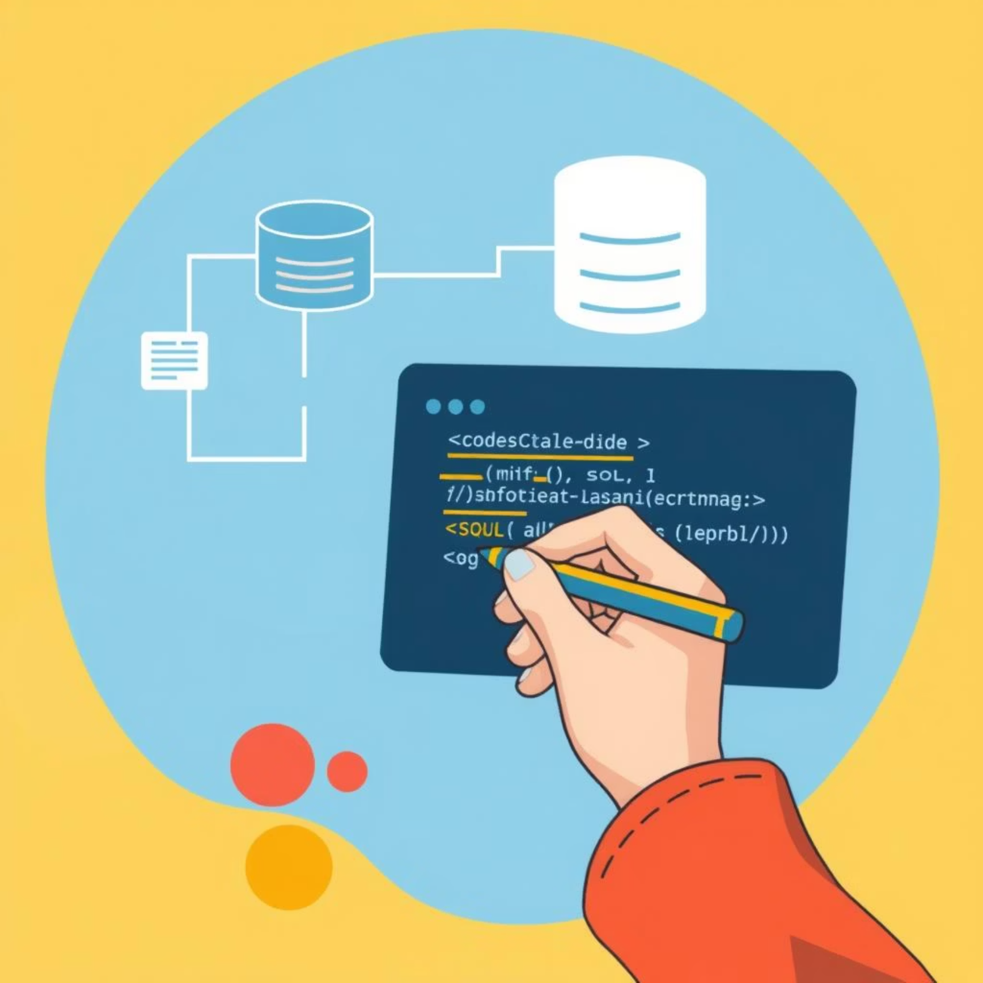

Manual PHP Migrations: A Foundational Approach
Crafting migrations manually involves writing PHP scripts that encapsulate SQL queries for schema modifications. This offers granular control and a deep understanding of database operations.
Create PHP scripts containing raw SQL for database operations.
Implement up() methods to apply schema changes.
Develop down() methods for safe migration rollbacks.
Maintain a dedicated migrations table to track applied changes.
This approach ensures full control but requires meticulous attention to detail and consistent naming conventions for manageability.

Slide 4

Example: A Simple Manual Migration
Define Your Schema
Implement up()
Begin by envisioning the table structure, for example, a messages table with id, content, and date_time fields.
Write the SQL query to create the table within the up() method of your migration class.
CREATE TABLE messages ( id INT AUTO_INCREMENT PRIMARY KEY, content TEXT NOT NULL, date_time DATETIME NOT NULL );
Implement down()
Console Script Execution
Create the SQL query for dropping the table in the down() method to enable rollbacks.
Develop a simple PHP console script to run these migrations, applying or reverting changes as needed.
DROP TABLE messages;

Slide 5
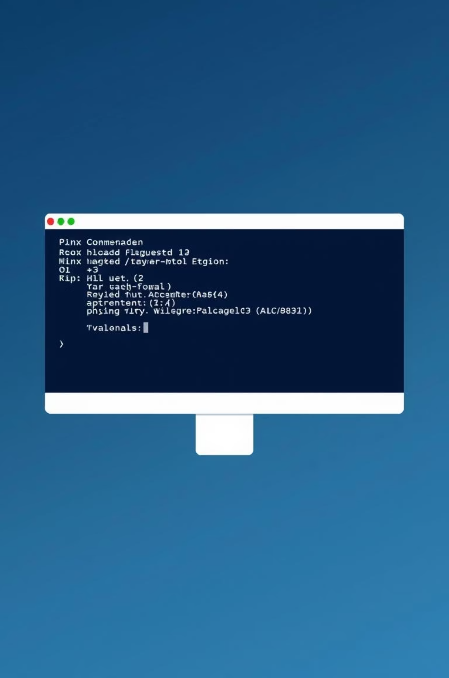

Phinx: Framework-Agnostic Migrations
Phinx is a widely-used, framework-independent migration tool that simplifies database version control.
Installation
1
composer require robmorgan/phinx
Initialisation
2
php vendor/robmorgan/phinx/bin/phinx init
This command generates a phinx.php configuration file.
Configuration
3
Edit phinx.php to set up your database connection details.

Slide 6




Working with Phinx: Creation and Execution
Generate Migration File
Use the command to create a new migration, which will generate a PHP file with a change() method.
php vendor/robmorgan/phinx/bin/phinx create CreateTableMessages
Define Schema Changes
Within the change() method, describe your desired database modifications. For instance, add content and date_time columns to your messages table.
$table = $this->table('messages'); $table->addColumn('content', 'text') ->addColumn('date_time', 'datetime') ->create();
Execute Migration
Run all pending migrations to apply changes to your database.
php vendor/robmorgan/phinx/bin/phinx migrate
Rollback Changes
If needed, you can easily revert the last applied migration.
php vendor/robmorgan/phinx/bin/phinx rollback

Slide 7
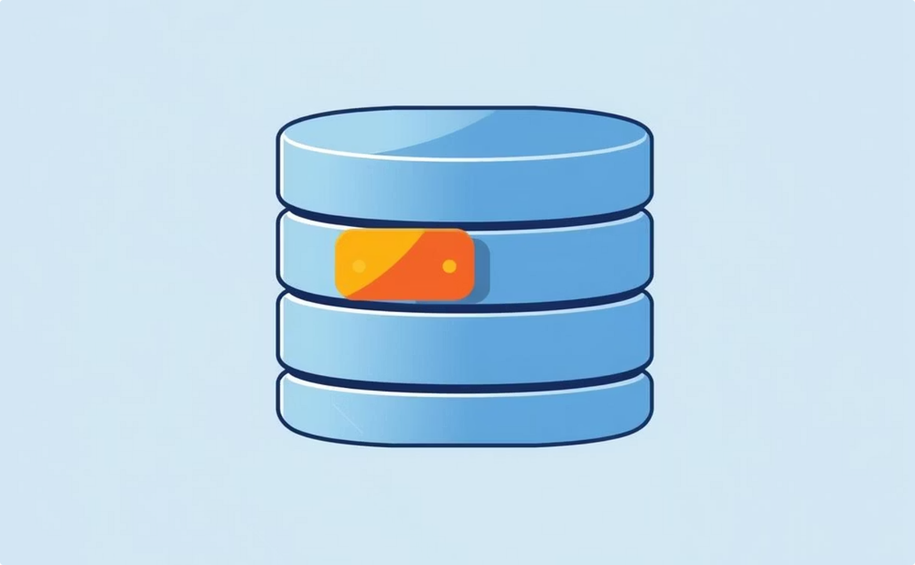
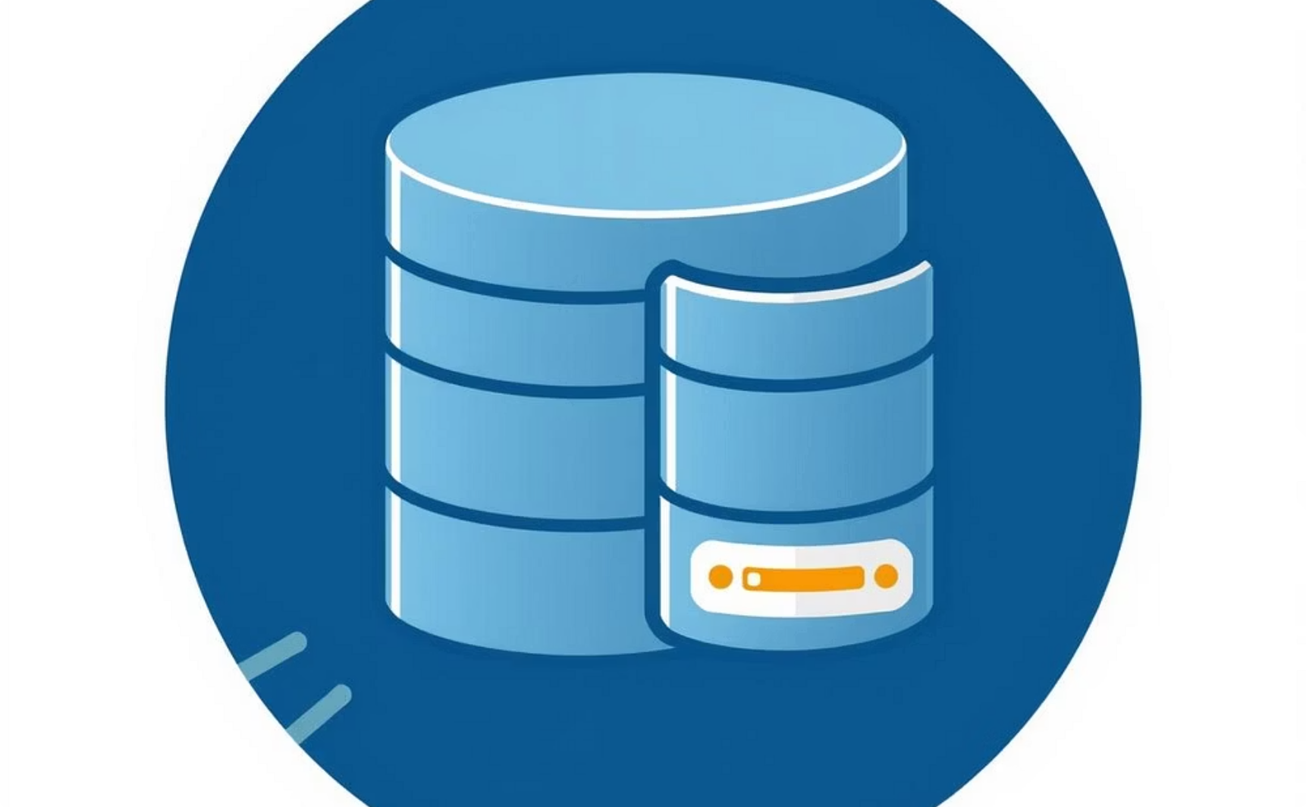
Alternatives: Lightweight Migration Tools
Simple-mysql-DB-migrator
Mysql Migration Manager
A minimalist PHP script designed for basic migration needs. It includes up()/down() methods and a configuration file for straightforward database management.
This tool automates migration creation by comparing current and target database schemas, generating the necessary SQL for changes.
Automated schema comparison.
Lightweight and easy to integrate.
Reduces manual SQL writing.
Ideal for small projects or specific tasks.
Both tools offer distinct advantages for projects that require migration capabilities without the overhead of a full framework.

Slide 8

Practical Tips for Unframeworked Migrations
Version Control Integration
Test Thoroughly
Always store your migration files within your version control system (e.g., Git). This ensures traceability and collaborative development.
Before deploying to production, rigorously test your migrations on a local or staging database environment to catch potential issues.
Migration Tracking
Documentation and Consistency
Utilise dedicated helper tables to keep a precise record of all executed migrations. This prevents re-running completed changes.
Document all schema changes and adhere to a consistent migration style across your project for better maintainability and clarity.

Slide 9
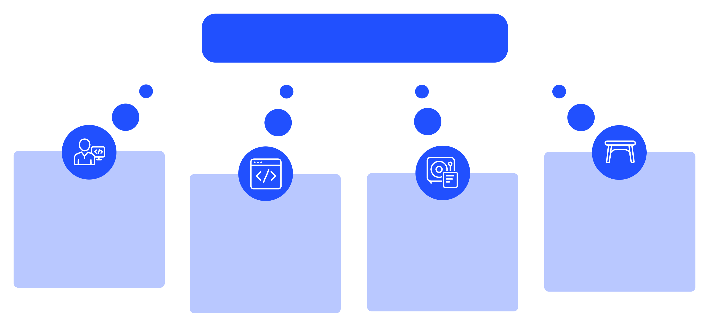
Visualising the Migration Workflow
Migration Workflow
Developer Triggers Migration
Migrations Table Updated
Run PHP Migration Script
Database Applies Changes
This workflow illustrates how migrations streamline collaboration and version control for database structures, ensuring all team members are on the same page.

Slide 10

Conclusion & Recommendations
Essential Tool
Reliable Solutions
Database migrations are a cornerstone for managing schema changes in PHP projects, even without complex frameworks.
Phinx and simple PHP scripts offer robust, automated solutions for effective migration management.
Early Adoption
Implement migrations from your project's inception to ensure stability and simplify future development.
Questions?
We're here to help you start building your database migrations today!

Slide 11




